Slide 1

Developer Track
#TEAM53

Slide 2
Our Team
Phani Shankar
(FSD)
Vamsi
(AWS+DevOps)
Bala Sundar
(FSD)
Satyanarayana
(Azure + DevOps)
Shaik Anwar
(FSD)
Murali Krishna
(FSD)

Slide 3
Introduction
The Developer Track website is a cutting-edge platform designed to streamline and enhance the tracking of developer activities beyond traditional office hours. Tailored specifically for remote work scenarios, this platform empowers developers to log and showcase their accomplishments during designated after-work hours, ensuring transparent communication and accountability.

Slide 4
Admin Supervision
Dynamic Profile Maintenance
FEATURES
Individual Work Tracking
Reporting and Analytics

Slide 5
PROBLEMS
Tracking and Showcasing After-Hours Work
Time Management and Productivity
Transparency and Accountability
Ensuring Data Privacy and Security

Slide 6
Technologies Used
Azure DevOps
MERN STACK
AWS DevOps
Deployment using
Azure C loud Platform.
Deployment using
AWS C loud Platform.
React JS Node JS Express JS Mongo DB

Slide 7
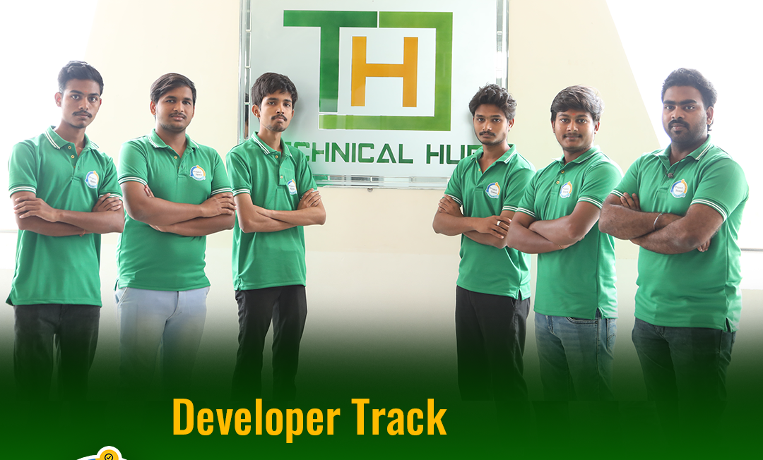
TEAM MEMBERS

Slide 8

Thank You

